Slide 1
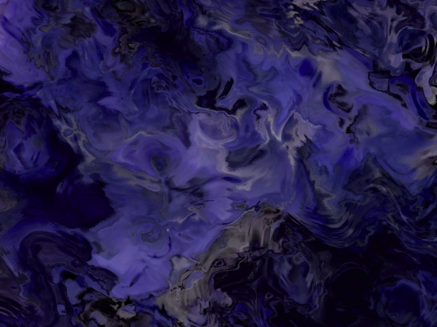
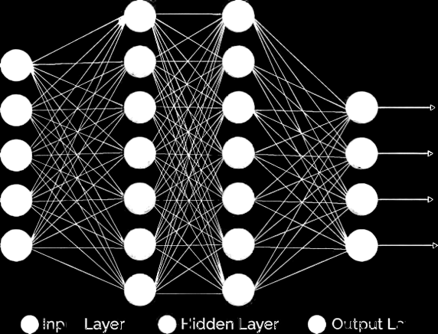
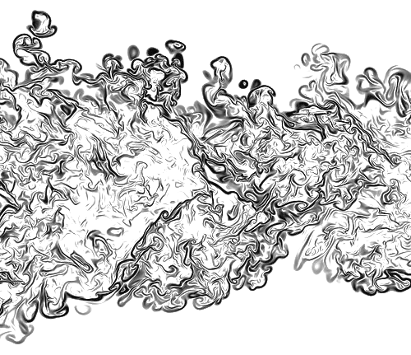
Data-Driven Fluid Dynamics
for turbulent flow modelling
Under the guidance of Prof. Rajaram Lakkaraju
Project by: Ritvik Pandey (16ME33014)
Notes:
Good morning sir, thanks for having me. I am Ritvik Pandey and today I am here to present my Master’s Thesis titled Data-Driven Fluid Dynamics for turbulent flow modelling under the guidance of Professor Rajaram Lakkaraju.

Slide 2
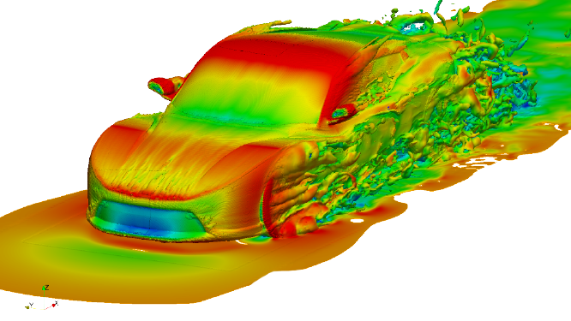
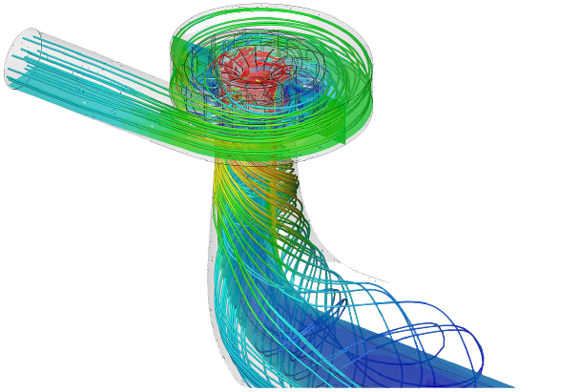
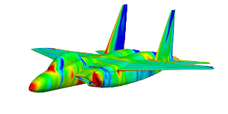
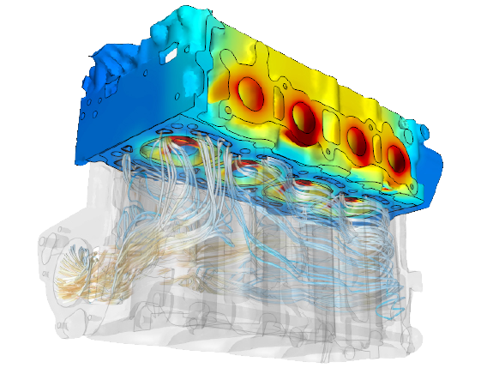
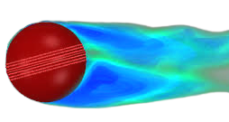
Computational Fluid Dynamics
Problem Statement
Fuel Efficiency of car
Lift balance and stealth of airplane
Heat flow and mixing in IC Engine
Swing of the cricket ball
Cooling systems on our laptops
Flow of molten metal
Notes:
So why is Fluid dynamics useful to us?
A lot of real world problems like:
Drag and lift forces on car which directly affects fuel efficiency
Similar forces on an airplane to keep it stable in mid air
Heat transfer and mixing in IC engines
Forces on cricket ball which causes swing
Cooling of our laptops
Flow of molten metal while manufacturing
They all require a solution to Navier Stokes equation which governs how fluid motion takes place. This equation is one of unsolved millennium problems and hence the technique of numerical simulations and experimental analysis is used.
While experiments produce more reliable results they aren’t easy to be conducted and require a costly wind tunnel setup making it infeasible to be used non-commercially
On the other hand, numerical simulations require a lot of computational resources and are very slow to be carried out even for simple geometries. This problem gets magnified when flow is turbulent in nature.

Slide 3
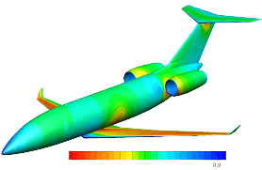
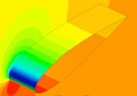
Real world requirements
Problem Statement
Aircraft Design Optimization
Iterative trial and error for new shapes
Wait time (weeks) for a single simulation to converge
Generating TBs of data while only using 8% of it to calculate the final lift and drag forces
Severely restricting the scope of new design and innovation
These limitations are directly because of the time and resource requirement of numerical simulations
Notes:
Lets see several real world examples
So I am a aircraft designer and I want to test some modifications which might give better lift to drag ratios. I have to test several different geometries and input velocities and see how the performance changes.
Each new simulation would take weeks to converge on the fastest of HPCs even when are done only for parts of the geometries. Not only that but it generates TBs of data where I only need surface values which might be just 8% of it
This all severely restricts my capabilities to try new geometries and bring revolutionary changes to the domain

Slide 4
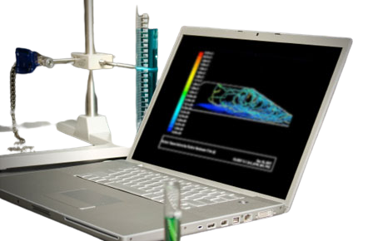
Real world requirements
Student Researcher
Inaccessability to High Performance Computers (HPC)
Most simulations could not run on laptop and takes days for a simple airfoil simulation
Unable to store this large amount of data on my machine
Hampering my ability to understand the field better with experimentations
These limitations are directly because of the time and resource requirement of numerical simulations
Problem Statement
Notes:
Another real world requirement could be that
I am student who just started with Computational Fluid Dynamics and want to experiment things on my own
I do not have access to high performance computers and have to run these simulations on my laptop which takes days even for simple 2D airfoil simulation
This also generated huge amount of data which is neither required for me nor is feasible to be stored locally
These all factors significantly contribute to hamper my ability to learn and understand the field better

Slide 5
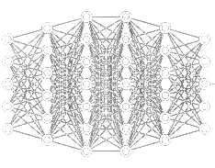
Why data-driven approaches
Advantages of Data-driven methods in CFD
High amount of already generated data that can be used to make good estimation of future results
Wealth of techniques that could be used to extract hidden and meaningful information
Simple to use and faster than conventional methods
Could be used to reduce the dimensionality of the problem
We aim to make this black box more transparent thus making AI-based systems more reliable
Problem Statement
Notes:
Why do we wish employ data-driven to our aid
Major requirement of these methods is already addressed by ample amount of data generated while simulations which could help in future estimation of results
These methods offer wealth of techniques which could be used to extract deeper meaningful information
These methods work a lot faster and are simpler to use hence removing the barrier of knowledge
They could be used to reduce the dimensionality of the problem thereby further making them easier to work with
The only problem with such approaches is that they work like a black box which we would try to solve in this work making them more reliable

Slide 6
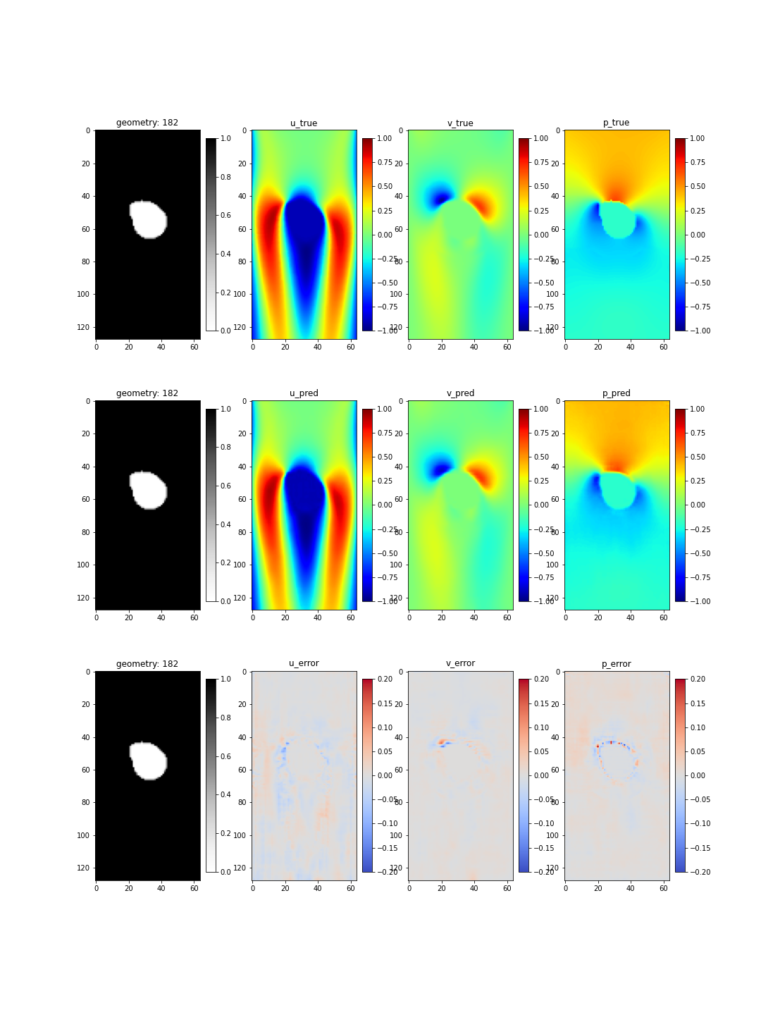
Thesis Goal
Problem Statement
We aim to create a system which can predict the mean turbulent flow field values around a 2D geometry in wind tunnel
u
Model
v
p
Geometry
Flow fields
Notes:
We aim to create a data-driven system which can predict the mean turbulent flow field values in a wind tunnel with just the geometrical information. This system is to be trained with multiple examples of the simulation results already created and must follow the baseline physics when predicting on newer geometries.

Slide 7
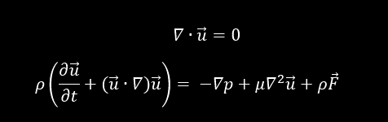
Reynolds Averaged Navier-Stokes (RANS)
Mass conservation
Momentum conservation
2. Theoretical
background
Notes:
Navier-Stokes equation is one of the most famous unsolved problems in mathematics which governs the fluid dynamics. They consist of a mass conservation equation and 3 equations for momentum conservation in 3 directions.
For making these partial differential equations faster to converge for turbulent systems, a mathematical technique of Reynolds Time averaging to both mass and momentum conservation is applied
U is the time averaged velocity and u’ is the turbulent fluctuations
Time averaging simplifies the equation to give Reynolds stress tensor and an easy to solve PDE in average velocities.
This stress tensor consists of squared fluctuation term which becomes significantly small for lower magnitude fluctuations. Also for steady state solutions, time derivative for time averaged mean velocity fields goes to 0
Even after these simplifications, it takes weeks to run a single large scale simulation

Slide 8
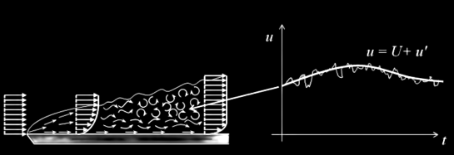
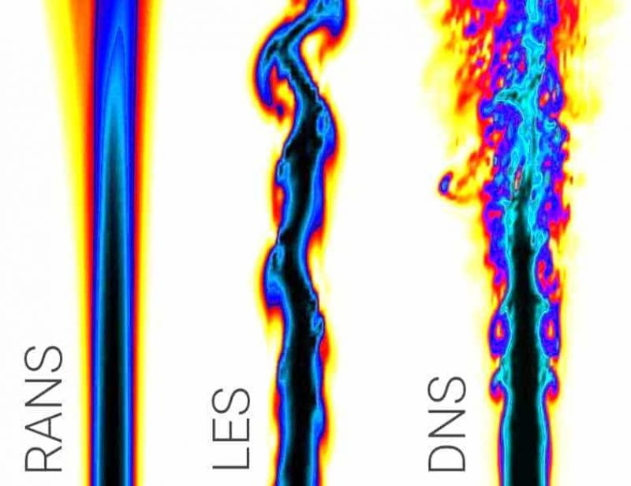
Reynolds Averaged Navier-Stokes (RANS)
Mass conservation
Momentum conservation
2. Theoretical
background
Notes:
Navier-Stokes equation is one of the most famous unsolved problems in mathematics which governs the fluid dynamics. They consist of a mass conservation equation and 3 equations for momentum conservation in 3 directions.
For making these partial differential equations faster to converge for turbulent systems, a mathematical technique of Reynolds Time averaging to both mass and momentum conservation is applied
U is the time averaged velocity and u’ is the turbulent fluctuations
Time averaging simplifies the equation to give Reynolds stress tensor and an easy to solve PDE in average velocities.
This stress tensor consists of squared fluctuation term which becomes significantly small for lower magnitude fluctuations. Also for steady state solutions, time derivative for time averaged mean velocity fields goes to 0
Even after these simplifications, it takes weeks to run a single large scale simulation

Slide 9
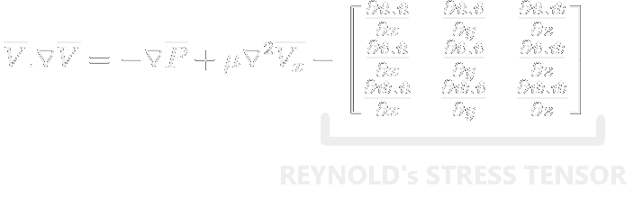
Reynolds Averaged Navier-Stokes (RANS)
Mass conservation
Momentum conservation
2. Theoretical
Even after this simplification it takes weeks to run a single simulation on large scale bodies
background
Steady State RANS equation
Notes:
Navier-Stokes equation is one of the most famous unsolved problems in mathematics which governs the fluid dynamics. They consist of a mass conservation equation and 3 equations for momentum conservation in 3 directions.
For making these partial differential equations faster to converge for turbulent systems, a mathematical technique of Reynolds Time averaging to both mass and momentum conservation is applied
U is the time averaged velocity and u’ is the turbulent fluctuations
Time averaging simplifies the equation to give Reynolds stress tensor and an easy to solve PDE in average velocities.
This stress tensor consists of squared fluctuation term which becomes significantly small for lower magnitude fluctuations. Also for steady state solutions, time derivative for time averaged mean velocity fields goes to 0
Even after these simplifications, it takes weeks to run a single large scale simulation

Slide 10
Convolutional Neural Networks (CNN)
2. Theoretical
background
Notes:
Convolution Neural Network is an artificial attempt of creating a brain like network with consideration of spatial proximity of data. This makes it widely used in images like unlocking phone with our face. The convolution filter is basically mathematical convolution operation in 2 and 3D. This operation has certain weights associated with corresponding filters followed by a certain activation function like a real neuron and each filter looks for certain features in the image. These are primary features like lines with different slopes in earlier layers of the network and higher order features like distinctive shapes in later layers.
With time these weights are tweaked as the network sees more training examples to finely extract features which are important from the image. Thus such a network could be easily used to extract essential features and do tasks like classification, regression and localization from them.

Slide 11
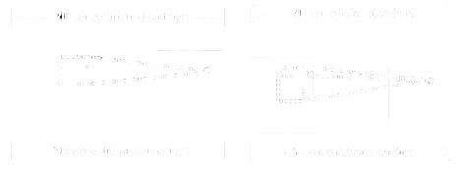

Convolutional Neural Networks (CNN)
Convolution operation in 2D and 3D
A similar but inverse operation is called DeConvolution
2. Theoretical
background
Notes:
Convolution Neural Network is an artificial attempt of creating a brain like network with consideration of spatial proximity of data. This makes it widely used in images like unlocking phone with our face. The convolution filter is basically mathematical convolution operation in 2 and 3D. This operation has certain weights associated with corresponding filters followed by a certain activation function like a real neuron and each filter looks for certain features in the image. These are primary features like lines with different slopes in earlier layers of the network and higher order features like distinctive shapes in later layers.
With time these weights are tweaked as the network sees more training examples to finely extract features which are important from the image. Thus such a network could be easily used to extract essential features and do tasks like classification, regression and localization from them.

Slide 12
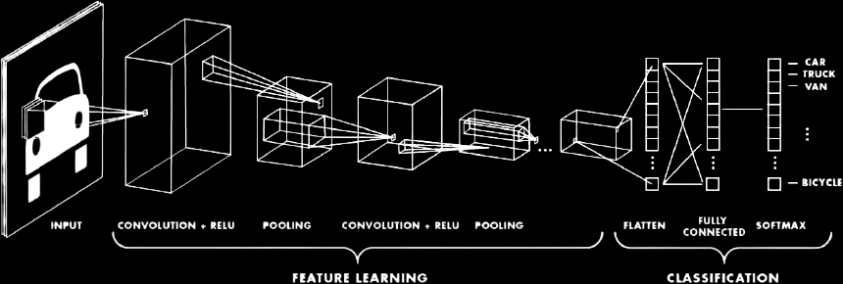
Convolutional Neural Networks (CNN)
Convolution operation in 2D and 3D
A similar but inverse operation is called DeConvolution
2. Theoretical
background
Notes:
Convolution Neural Network is an artificial attempt of creating a brain like network with consideration of spatial proximity of data. This makes it widely used in images like unlocking phone with our face. The convolution filter is basically mathematical convolution operation in 2 and 3D. This operation has certain weights associated with corresponding filters followed by a certain activation function like a real neuron and each filter looks for certain features in the image. These are primary features like lines with different slopes in earlier layers of the network and higher order features like distinctive shapes in later layers.
With time these weights are tweaked as the network sees more training examples to finely extract features which are important from the image. Thus such a network could be easily used to extract essential features and do tasks like classification, regression and localization from them.

Slide 13
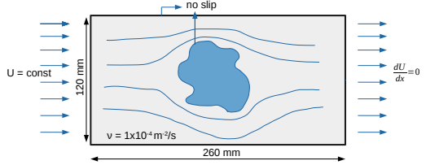
Data Generation
3. Methodology
Notes:
Generating large amount of simulation data was not possible on the laptop but thats what makes this model special. Instead of other models of similar scale which requires 10k+ samples, I was able to train and generalize the results of the model with as less as 700 samples due to the physics constraints we applied for faster convergence.
RANS Simulations were performed on OpenFOAM solver. The domain dimensions are 260 mm in the stream-wise direction and 120 mm in the direction perpendicular to the flow which were later resized to 128x64 pixels using cubic interpolation.
The number of grid elements varies according to the shape used, but with a base cell size of around 1 mm
the average cell count is about 30,000.
Boundary conditions are kept fixed, with a constant velocity of 1 m/s on the inlet (left wall), a zero gradient condition on the outlet (right wall), and no-slip boundary condition on the top/bottom and obstacle walls.
Furthermore, the laminar dynamic viscosity is set to 1 × 10⁻⁴ m²/s
For making it easier to perceive distance, signed distance field is computer from the surface of the body and from the channel and added as an input to the model

Slide 14
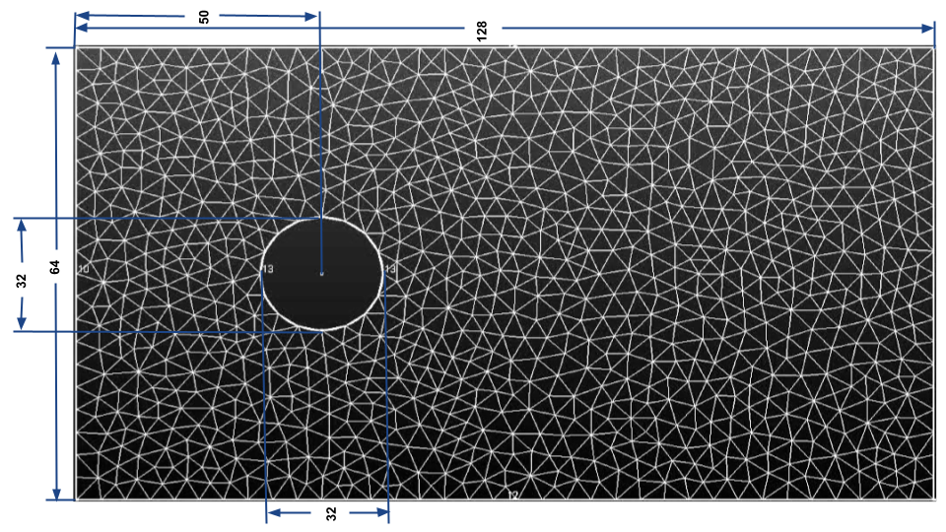
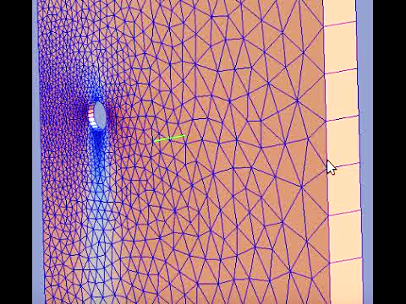
Data Generation
3. Methodology
Notes:
Generating large amount of simulation data was not possible on the laptop but thats what makes this model special. Instead of other models of similar scale which requires 10k+ samples, I was able to train and generalize the results of the model with as less as 700 samples due to the physics constraints we applied for faster convergence.
RANS Simulations were performed on OpenFOAM solver. The domain dimensions are 260 mm in the stream-wise direction and 120 mm in the direction perpendicular to the flow which were later resized to 128x64 pixels using cubic interpolation.
The number of grid elements varies according to the shape used, but with a base cell size of around 1 mm
the average cell count is about 30,000.
Boundary conditions are kept fixed, with a constant velocity of 1 m/s on the inlet (left wall), a zero gradient condition on the outlet (right wall), and no-slip boundary condition on the top/bottom and obstacle walls.
Furthermore, the laminar dynamic viscosity is set to 1 × 10⁻⁴ m²/s
For making it easier to perceive distance, signed distance field is computer from the surface of the body and from the channel and added as an input to the model

Slide 15
Data Generation
3. Methodology
Domain : 260mm x 120mm
Cell size : 1mm
Cell count : 30,000
Inlet velocity : 1m/s
Dynamic viscosity : 10⁻⁴ m²/s
Re (shape-specific) : 600-1000
Notes:
Generating large amount of simulation data was not possible on the laptop but thats what makes this model special. Instead of other models of similar scale which requires 10k+ samples, I was able to train and generalize the results of the model with as less as 700 samples due to the physics constraints we applied for faster convergence.
RANS Simulations were performed on OpenFOAM solver. The domain dimensions are 260 mm in the stream-wise direction and 120 mm in the direction perpendicular to the flow which were later resized to 128x64 pixels using cubic interpolation.
The number of grid elements varies according to the shape used, but with a base cell size of around 1 mm
the average cell count is about 30,000.
Boundary conditions are kept fixed, with a constant velocity of 1 m/s on the inlet (left wall), a zero gradient condition on the outlet (right wall), and no-slip boundary condition on the top/bottom and obstacle walls.
Furthermore, the laminar dynamic viscosity is set to 1 × 10⁻⁴ m²/s
For making it easier to perceive distance for the model, signed distance field is computer from the surface of the body and from the channel and added as an input to the model

Slide 16
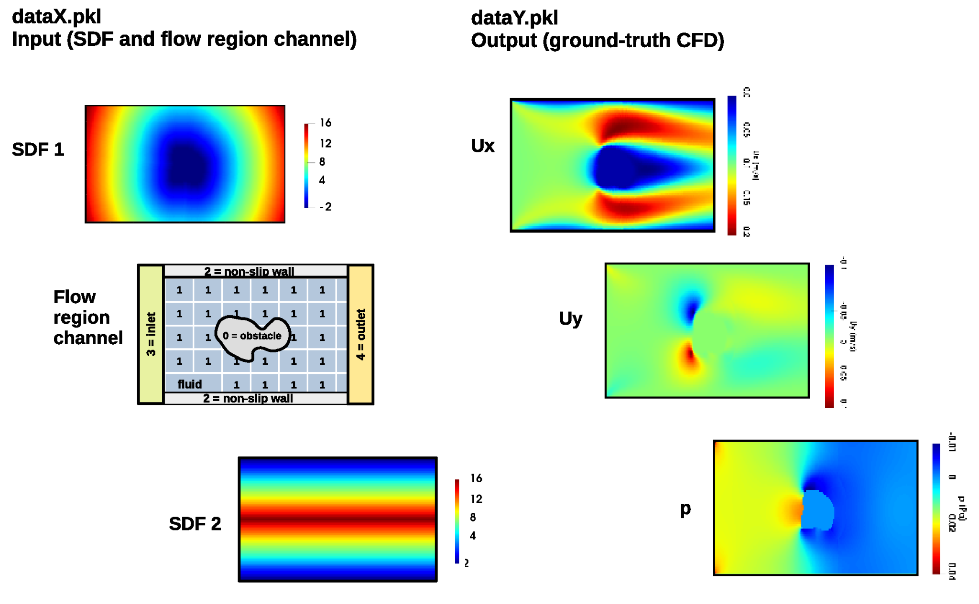
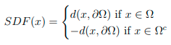
Data Generation
3. Methodology
SDF1
SDF2
Domain : 260mm x 120mm
Cell size : 1mm
Cell count : 30,000
Inlet velocity : 1m/s
Dynamic viscosity : 10⁻⁴ m²/s
Re (shape-specific) : 600-1000
Shape Info
Notes:
Generating large amount of simulation data was not possible on the laptop but thats what makes this model special. Instead of other models of similar scale which requires 10k+ samples, I was able to train and generalize the results of the model with as less as 700 samples due to the physics constraints we applied for faster convergence.
RANS Simulations were performed on OpenFOAM solver. The domain dimensions are 260 mm in the stream-wise direction and 120 mm in the direction perpendicular to the flow which were later resized to 128x64 pixels using cubic interpolation.
The number of grid elements varies according to the shape used, but with a base cell size of around 1 mm
the average cell count is about 30,000.
Boundary conditions are kept fixed, with a constant velocity of 1 m/s on the inlet (left wall), a zero gradient condition on the outlet (right wall), and no-slip boundary condition on the top/bottom and obstacle walls.
Furthermore, the laminar dynamic viscosity is set to 1 × 10⁻⁴ m²/s
For making it easier to perceive distance for the model, signed distance field is computer from the surface of the body and from the channel and added as an input to the model

Slide 17
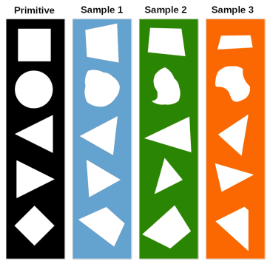
Data Generation
Base shape
Gen 1
Gen 2
Gen 3
3. Methodology
Primary shapes : circle, square, forward triangle, backward triangle, rhombus
Training and testing count : 700 samples, 300 samples
Total simulation time : 150+ hours
Notes:
Apart from 700 samples to train, 300 other simulations were done to create a dataset for testing our results. The geometries for them were created using the generator that creates obstacle shapes based on five different primitive shapes (circle, square, forward-facing triangle, backward-backing triangle, and rhombus) by randomly shifting the points used to construct these shapes in a given range of directions. Hence a total of 1000 RANS simulations which took close to 10min per simulation.

Slide 18
DeepSteadyNS Architecture
Network Architecture
shape
skip connection
U_{x}, U_{y}, P
2x2x512
1x1x512
2x2x512
4x4x512
4x4x512
8x8x128
8x8x128
16x16x64
16x16x64
32x32x16
32x32x16
128x64x1
64x64x8
64x64x8
128x64x3
Encoder
Bottleneck
Decoder
Notes:
I present you DeepSteadyNS, a fully convolutional neural network based UNET architecture.
Unet architecture has a down-sampling encoder network compresses the geometric information (SDF) into a reduced dimension latent space or latent geometry representation (LGR), followed by an up-sampling decoder network that maps the LGR encodings to field components (u, v, p fields)
The key component of this architecture is the skip connections from encoder to decoder which creates the flow based on encoded geometric features at the corresponding feature maps. This sharing of encoding layers preserved the sharp edges and is better at mapping abrupt changes in field values at those geometrical features.

Slide 19
Loss function
Mean Squared Error (MSE)
y_{true}
y_{pred}
MSE = ( y_{pred} - y_{true} )² / n
Cosine Proximity
(y_{pred} . y_{true}) / (|y_{pred}||y_{true}|)
3. Methodology
Notes:
Each Neural Network based architecture has a loss function which gives it an estimate of how close the network’s prediction are to the real values. Hence the standard way to make this function is to give a mean squared error (MSE) of every pixel value. There is also a cosine proximity calculation by taking dot product of predicted and true field maps divided by product of their determinants.
I would like to introduce a new kind of loss function for this problem which takes into account the physics of the problem. This not only speeds up convergence and require significantly lesser number of training sample but also ensures that our predictions show as less deviation from real world physics as possible hence improving the reliability of these data-driven methods beyond considering them black boxes
Here, we will call it Navier-Stokes based loss or NS-loss which has 3 component for a 2D flow.
The first component comes from the continuity equation called the continuity loss
Other two components are from momentum equations
Squared summation of all these components would give us the NS-loss which can be easily generalized to 3 dimensions
For a low fluctuation amplitude turbulent flows, all these components must be close to 0. As a network never explicitly makes them zero, all the rest deviation is directly contributed by Reynolds stress terms addressed earlier.
Total loss function used by us in the model training is summation of MSE and NS-loss

Slide 20
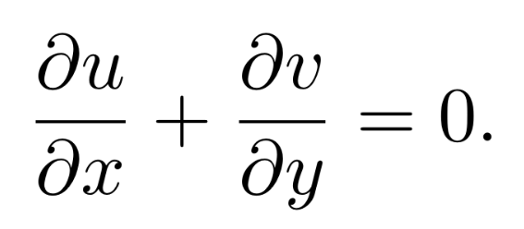
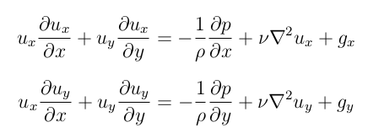
Loss function
Mean Squared Error (MSE)
y_{true}
y_{pred}
Navier-Stokes equation (2D)
MSE = ( y_{pred} - y_{true} )² / n
Cosine Proximity
(y_{pred} . y_{true}) / (|y_{pred}||y_{true}|)
3. Methodology
Notes:
Each Neural Network based architecture has a loss function which gives it an estimate of how close the network’s prediction are to the real values. Hence the standard way to make this function is to give a mean squared error (MSE) of every pixel value. There is also a cosine proximity calculation by taking dot product of predicted and true field maps divided by product of their determinants.
I would like to introduce a new kind of loss function for this problem which takes into account the physics of the problem. This not only speeds up convergence and require significantly lesser number of training sample but also ensures that our predictions show as less deviation from real world physics as possible hence improving the reliability of these data-driven methods beyond considering them black boxes
Here, we will call it Navier-Stokes based loss or NS-loss which has 3 component for a 2D flow.
The first component comes from the continuity equation called the continuity loss
Other two components are from momentum equations
Squared summation of all these components would give us the NS-loss which can be easily generalized to 3 dimensions
For a low fluctuation amplitude turbulent flows, all these components must be close to 0. As a network never explicitly makes them zero, all the rest deviation is directly contributed by Reynolds stress terms addressed earlier.
Total loss function used by us in the model training is summation of MSE and NS-loss

Slide 21
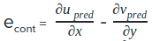
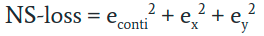
Loss function
Mean Squared Error (MSE)
y_{true}
y_{pred}
Navier-Stokes equation (2D)
MSE = ( y_{pred} - y_{true} )² / n
Cosine Proximity
(y_{pred} . y_{true}) / (|y_{pred}||y_{true}|)
3. Methodology
Navier-Stokes loss
(Physics based loss function)
Notes:
Each Neural Network based architecture has a loss function which gives it an estimate of how close the network’s prediction are to the real values. Hence the standard way to make this function is to give a mean squared error (MSE) of every pixel value. There is also a cosine proximity calculation by taking dot product of predicted and true field maps divided by product of their determinants.
I would like to introduce a new kind of loss function for this problem which takes into account the physics of the problem. This not only speeds up convergence and require significantly lesser number of training sample but also ensures that our predictions show as less deviation from real world physics as possible hence improving the reliability of these data-driven methods beyond considering them black boxes
Here, we will call it Navier-Stokes based loss or NS-loss which has 3 component for a 2D flow.
The first component comes from the continuity equation called the continuity loss
Other two components are from momentum equations
Squared summation of all these components would give us the NS-loss which can be easily generalized to 3 dimensions
For a low fluctuation amplitude turbulent flows, all these components must be close to 0. As a network never explicitly makes them zero, all the rest deviation is directly contributed by Reynolds stress terms addressed earlier.
Total loss function used by us in the model training is summation of MSE and NS-loss

Slide 22
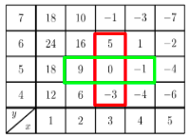
Loss function
Mean Squared Error (MSE)
y_{true}
y_{pred}
Navier-Stokes equation (2D)
MSE = ( y_{pred} - y_{true} )² / n
Cosine Proximity
(y_{pred} . y_{true}) / (|y_{pred}||y_{true}|)
3. Methodology
Partial Derivatives calculated using image_gradient methods from tensorflow library
Navier-Stokes loss
(Physics based loss function)
Final Loss function:
MSE + NS-loss
Notes:
Each Neural Network based architecture has a loss function which gives it an estimate of how close the network’s prediction are to the real values. Hence the standard way to make this function is to give a mean squared error (MSE) of every pixel value. There is also a cosine proximity calculation by taking dot product of predicted and true field maps divided by product of their determinants.
I would like to introduce a new kind of loss function for this problem which takes into account the physics of the problem. This not only speeds up convergence and require significantly lesser number of training sample but also ensures that our predictions show as less deviation from real world physics as possible hence improving the reliability of these data-driven methods beyond considering them black boxes
Here, we will call it Navier-Stokes based loss or NS-loss which has 3 component for a 2D flow.
The first component comes from the continuity equation called the continuity loss
Other two components are from momentum equations
Squared summation of all these components would give us the NS-loss which can be easily generalized to 3 dimensions
For a low fluctuation amplitude turbulent flows, all these components must be close to 0. As a network never explicitly makes them zero, all the rest deviation is directly contributed by Reynolds stress terms addressed earlier.
Total loss function used by us in the model training is summation of MSE and NS-loss

Slide 23

Results
RANS Solver
DeepSteadyNS
Notes:
We now fed the geometry to both RANS solver and our model

Slide 24
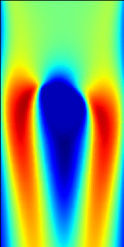
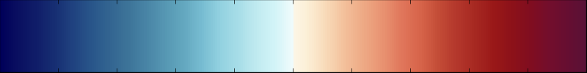
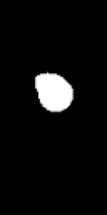
Example Results
0.2
u_true
1.00
MSE : 2.8%
MAE : 5.6%
Cosine proximity : 0.997
-0.2
-1.00
4. Results
Notes:
We shall now watch the results more closely and look for errors.
This is the true velocity in x-direction denoted by u_true computed from a RANS solver
This is the predicted velocity in x-direction denoted by u_pred by our model
Subtracting predicted u fields from true values resulted in this error map
Similarly, here is the true velocity in y direction denoted by v
And here is predicted velocity in y direction by our model
And this is the error between predicted and true values
Finally this is true pressure value
This is pressure fields predicted by our model
And this is the prediction error in pressure fields
The mean squared error for this sample was 2.8% while the mean absolute error was 5.6%. The average cosine proximity of all the fields was 0.997

Slide 25
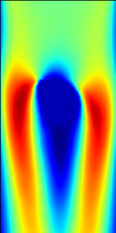
Example Results
0.2
u_true
u_pred
1.00
MSE : 2.8%
MAE : 5.6%
Cosine proximity : 0.997
-0.2
-1.00
4. Results
Notes:
We shall now watch the results more closely and look for errors.
This is the true velocity in x-direction denoted by u_true computed from a RANS solver
This is the predicted velocity in x-direction denoted by u_pred by our model
Subtracting predicted u fields from true values resulted in this error map
Similarly, here is the true velocity in y direction denoted by v
And here is predicted velocity in y direction by our model
And this is the error between predicted and true values
Finally this is true pressure value
This is pressure fields predicted by our model
And this is the prediction error in pressure fields
The mean squared error for this sample was 2.8% while the mean absolute error was 5.6%. The average cosine proximity of all the fields was 0.997

Slide 26
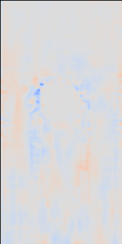
Example Results
0.2
u_true
u_pred
u_error
1.00
MSE : 2.8%
MAE : 5.6%
Cosine proximity : 0.997
-0.2
-1.00
4. Results
Notes:
We shall now watch the results more closely and look for errors.
This is the true velocity in x-direction denoted by u_true computed from a RANS solver
This is the predicted velocity in x-direction denoted by u_pred by our model
Subtracting predicted u fields from true values resulted in this error map
Similarly, here is the true velocity in y direction denoted by v
And here is predicted velocity in y direction by our model
And this is the error between predicted and true values
Finally this is true pressure value
This is pressure fields predicted by our model
And this is the prediction error in pressure fields
The mean squared error for this sample was 2.8% while the mean absolute error was 5.6%. The average cosine proximity of all the fields was 0.997

Slide 27
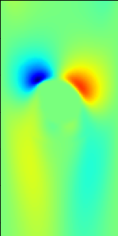
Example Results
0.2
u_true
u_pred
u_error
1.00
MSE : 2.8%
MAE : 5.6%
Cosine proximity : 0.997
v_true
-0.2
-1.00
4. Results
Notes:
We shall now watch the results more closely and look for errors.
This is the true velocity in x-direction denoted by u_true computed from a RANS solver
This is the predicted velocity in x-direction denoted by u_pred by our model
Subtracting predicted u fields from true values resulted in this error map
Similarly, here is the true velocity in y direction denoted by v
And here is predicted velocity in y direction by our model
And this is the error between predicted and true values
Finally this is true pressure value
This is pressure fields predicted by our model
And this is the prediction error in pressure fields
The mean squared error for this sample was 2.8% while the mean absolute error was 5.6%. The average cosine proximity of all the fields was 0.997

Slide 28

Example Results
0.2
u_true
u_pred
u_error
1.00
MSE : 2.8%
MAE : 5.6%
Cosine proximity : 0.997
v_true
v_pred
-0.2
-1.00
4. Results
Notes:
We shall now watch the results more closely and look for errors.
This is the true velocity in x-direction denoted by u_true computed from a RANS solver
This is the predicted velocity in x-direction denoted by u_pred by our model
Subtracting predicted u fields from true values resulted in this error map
Similarly, here is the true velocity in y direction denoted by v
And here is predicted velocity in y direction by our model
And this is the error between predicted and true values
Finally this is true pressure value
This is pressure fields predicted by our model
And this is the prediction error in pressure fields
The mean squared error for this sample was 2.8% while the mean absolute error was 5.6%. The average cosine proximity of all the fields was 0.997

Slide 29
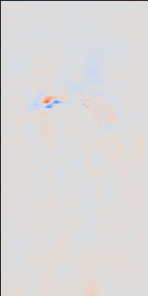
Example Results
0.2
u_true
u_pred
u_error
1.00
MSE : 2.8%
MAE : 5.6%
Cosine proximity : 0.997
v_true
v_pred
v_error
-0.2
-1.00
4. Results
Notes:
We shall now watch the results more closely and look for errors.
This is the true velocity in x-direction denoted by u_true computed from a RANS solver
This is the predicted velocity in x-direction denoted by u_pred by our model
Subtracting predicted u fields from true values resulted in this error map
Similarly, here is the true velocity in y direction denoted by v
And here is predicted velocity in y direction by our model
And this is the error between predicted and true values
Finally this is true pressure value
This is pressure fields predicted by our model
And this is the prediction error in pressure fields
The mean squared error for this sample was 2.8% while the mean absolute error was 5.6%. The average cosine proximity of all the fields was 0.997

Slide 30
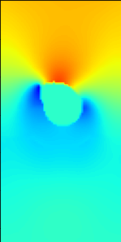
Example Results
0.2
u_true
u_pred
u_error
1.00
MSE : 2.8%
MAE : 5.6%
Cosine proximity : 0.997
v_true
v_pred
v_error
-0.2
-1.00
4. Results
p_true
Notes:
We shall now watch the results more closely and look for errors.
This is the true velocity in x-direction denoted by u_true computed from a RANS solver
This is the predicted velocity in x-direction denoted by u_pred by our model
Subtracting predicted u fields from true values resulted in this error map
Similarly, here is the true velocity in y direction denoted by v
And here is predicted velocity in y direction by our model
And this is the error between predicted and true values
Finally this is true pressure value
This is pressure fields predicted by our model
And this is the prediction error in pressure fields
The mean squared error for this sample was 2.8% while the mean absolute error was 5.6%. The average cosine proximity of all the fields was 0.997

Slide 31
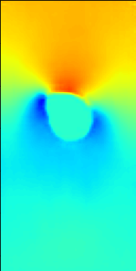
Example Results
0.2
u_true
u_pred
u_error
1.00
MSE : 2.8%
MAE : 5.6%
Cosine proximity : 0.997
v_true
v_pred
v_error
-0.2
-1.00
4. Results
p_true
p_pred
Notes:
We shall now watch the results more closely and look for errors.
This is the true velocity in x-direction denoted by u_true computed from a RANS solver
This is the predicted velocity in x-direction denoted by u_pred by our model
Subtracting predicted u fields from true values resulted in this error map
Similarly, here is the true velocity in y direction denoted by v
And here is predicted velocity in y direction by our model
And this is the error between predicted and true values
Finally this is true pressure value
This is pressure fields predicted by our model
And this is the prediction error in pressure fields
The mean squared error for this sample was 2.8% while the mean absolute error was 5.6%. The average cosine proximity of all the fields was 0.997

Slide 32
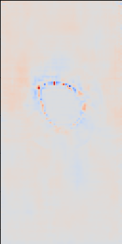
Example Results
0.2
u_true
u_pred
u_error
1.00
MSE : 2.8%
MAE : 5.6%
Cosine proximity : 0.997
v_true
v_pred
v_error
-0.2
-1.00
4. Results
p_true
p_pred
p_error
Notes:
We shall now watch the results more closely and look for errors.
This is the true velocity in x-direction denoted by u_true computed from a RANS solver
This is the predicted velocity in x-direction denoted by u_pred by our model
Subtracting predicted u fields from true values resulted in this error map
Similarly, here is the true velocity in y direction denoted by v
And here is predicted velocity in y direction by our model
And this is the error between predicted and true values
Finally this is true pressure value
This is pressure fields predicted by our model
And this is the prediction error in pressure fields
The mean squared error for this sample was 2.8% while the mean absolute error was 5.6%. The average cosine proximity of all the fields was 0.997

Slide 33
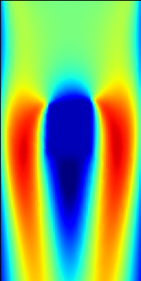
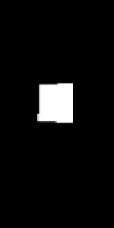
Example Results
0.2
u_true
1.00
-0.2
-1.00
4. Results
Notes:
Lets look at another sample
This is the true velocity in x-direction denoted by u_true computed from a RANS solver
This is the predicted velocity in x-direction denoted by u_pred by our model
Subtracting predicted u fields from true values resulted in this error map
Similarly, here is the true velocity in y direction denoted by v
And here is predicted velocity in y direction by our model
And this is the error between predicted and true values
Finally this is true pressure value
This is pressure fields predicted by our model
And this is the prediction error in pressure fields
The mean squared error for this sample was 3.2% while the mean absolute error was 6.1%. The average cosine proximity of all the fields was 0.995

Slide 34
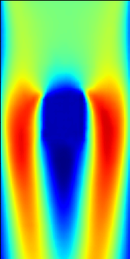
Example Results
0.2
u_true
u_pred
1.00
MSE : 3.2%
MAE :
6.1%
Cosine proximity : 0.994
-0.2
-1.00
4. Results
Notes:
Lets look at another sample
This is the true velocity in x-direction denoted by u_true computed from a RANS solver
This is the predicted velocity in x-direction denoted by u_pred by our model
Subtracting predicted u fields from true values resulted in this error map
Similarly, here is the true velocity in y direction denoted by v
And here is predicted velocity in y direction by our model
And this is the error between predicted and true values
Finally this is true pressure value
This is pressure fields predicted by our model
And this is the prediction error in pressure fields
The mean squared error for this sample was 3.2% while the mean absolute error was 6.1%. The average cosine proximity of all the fields was 0.995

Slide 35
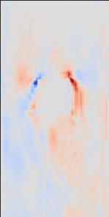
Example Results
0.2
u_true
u_pred
u_error
1.00
MSE : 3.2%
MAE :
6.1%
Cosine proximity : 0.994
-0.2
-1.00
4. Results
Notes:
Lets look at another sample
This is the true velocity in x-direction denoted by u_true computed from a RANS solver
This is the predicted velocity in x-direction denoted by u_pred by our model
Subtracting predicted u fields from true values resulted in this error map
Similarly, here is the true velocity in y direction denoted by v
And here is predicted velocity in y direction by our model
And this is the error between predicted and true values
Finally this is true pressure value
This is pressure fields predicted by our model
And this is the prediction error in pressure fields
The mean squared error for this sample was 3.2% while the mean absolute error was 6.1%. The average cosine proximity of all the fields was 0.995

Slide 36
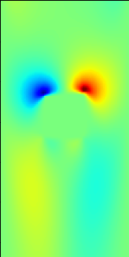
Example Results
0.2
u_true
u_pred
u_error
1.00
MSE : 3.2%
MAE :
6.1%
Cosine proximity : 0.994
v_true
-0.2
-1.00
4. Results
Notes:
Lets look at another sample
This is the true velocity in x-direction denoted by u_true computed from a RANS solver
This is the predicted velocity in x-direction denoted by u_pred by our model
Subtracting predicted u fields from true values resulted in this error map
Similarly, here is the true velocity in y direction denoted by v
And here is predicted velocity in y direction by our model
And this is the error between predicted and true values
Finally this is true pressure value
This is pressure fields predicted by our model
And this is the prediction error in pressure fields
The mean squared error for this sample was 3.2% while the mean absolute error was 6.1%. The average cosine proximity of all the fields was 0.995

Slide 37
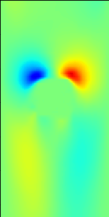
Example Results
0.2
u_true
u_pred
u_error
1.00
MSE : 3.2%
MAE :
6.1%
Cosine proximity : 0.994
v_true
v_pred
-0.2
-1.00
4. Results
Notes:
Lets look at another sample
This is the true velocity in x-direction denoted by u_true computed from a RANS solver
This is the predicted velocity in x-direction denoted by u_pred by our model
Subtracting predicted u fields from true values resulted in this error map
Similarly, here is the true velocity in y direction denoted by v
And here is predicted velocity in y direction by our model
And this is the error between predicted and true values
Finally this is true pressure value
This is pressure fields predicted by our model
And this is the prediction error in pressure fields
The mean squared error for this sample was 3.2% while the mean absolute error was 6.1%. The average cosine proximity of all the fields was 0.995

Slide 38
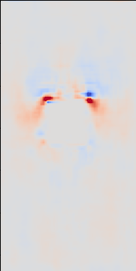
Example Results
0.2
u_true
u_pred
u_error
1.00
MSE : 3.2%
MAE :
6.1%
Cosine proximity : 0.994
v_true
v_pred
v_error
-0.2
-1.00
4. Results
Notes:
Lets look at another sample
This is the true velocity in x-direction denoted by u_true computed from a RANS solver
This is the predicted velocity in x-direction denoted by u_pred by our model
Subtracting predicted u fields from true values resulted in this error map
Similarly, here is the true velocity in y direction denoted by v
And here is predicted velocity in y direction by our model
And this is the error between predicted and true values
Finally this is true pressure value
This is pressure fields predicted by our model
And this is the prediction error in pressure fields
The mean squared error for this sample was 3.2% while the mean absolute error was 6.1%. The average cosine proximity of all the fields was 0.995

Slide 39
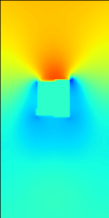
Example Results
0.2
u_true
u_pred
u_error
1.00
MSE : 3.2%
MAE :
6.1%
Cosine proximity : 0.994
v_true
v_pred
v_error
-0.2
-1.00
4. Results
p_true
Notes:
Lets look at another sample
This is the true velocity in x-direction denoted by u_true computed from a RANS solver
This is the predicted velocity in x-direction denoted by u_pred by our model
Subtracting predicted u fields from true values resulted in this error map
Similarly, here is the true velocity in y direction denoted by v
And here is predicted velocity in y direction by our model
And this is the error between predicted and true values
Finally this is true pressure value
This is pressure fields predicted by our model
And this is the prediction error in pressure fields
The mean squared error for this sample was 3.2% while the mean absolute error was 6.1%. The average cosine proximity of all the fields was 0.995

Slide 40
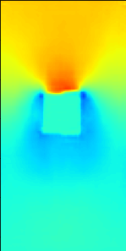
Example Results
0.2
u_true
u_pred
u_error
1.00
MSE : 3.2%
MAE :
6.1%
Cosine proximity : 0.994
v_true
v_pred
v_error
-0.2
-1.00
4. Results
p_true
p_pred
Notes:
Lets look at another sample
This is the true velocity in x-direction denoted by u_true computed from a RANS solver
This is the predicted velocity in x-direction denoted by u_pred by our model
Subtracting predicted u fields from true values resulted in this error map
Similarly, here is the true velocity in y direction denoted by v
And here is predicted velocity in y direction by our model
And this is the error between predicted and true values
Finally this is true pressure value
This is pressure fields predicted by our model
And this is the prediction error in pressure fields
The mean squared error for this sample was 3.2% while the mean absolute error was 6.1%. The average cosine proximity of all the fields was 0.995

Slide 41
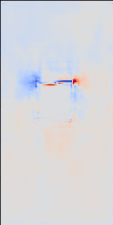
Example Results
0.2
u_true
u_pred
u_error
1.00
MSE : 3.2%
MAE :
6.1%
Cosine proximity : 0.994
v_true
v_pred
v_error
-0.2
-1.00
4. Results
p_true
p_pred
p_error
Notes:
Lets look at another sample
This is the true velocity in x-direction denoted by u_true computed from a RANS solver
This is the predicted velocity in x-direction denoted by u_pred by our model
Subtracting predicted u fields from true values resulted in this error map
Similarly, here is the true velocity in y direction denoted by v
And here is predicted velocity in y direction by our model
And this is the error between predicted and true values
Finally this is true pressure value
This is pressure fields predicted by our model
And this is the prediction error in pressure fields
The mean squared error for this sample was 3.2% while the mean absolute error was 6.1%. The average cosine proximity of all the fields was 0.995

Slide 42










Example Results
0.2
u_true
u_pred
u_error
1.00
MSE :
3.1%
MAE : 5.9%
Cosine proximity : 0.995
v_true
v_pred
v_error
-0.2
-1.00
4. Results
p_true
p_pred
p_error
Notes:
I just glance through few other examples.
This one is for triangle based geometry

Slide 43










Example Results
0.2
u_true
u_pred
u_error
1.00
MSE : 2.9%
MAE : 5.8%
Cosine proximity : 0.996
v_true
v_pred
v_error
-0.2
-1.00
4. Results
p_true
p_pred
p_error
Notes:
These are the results of a rhombus like geometry. As it can be seen, the errors for all these plots lay fairly low in the range of 5-6% showcasing the tradeoff of accuracy we had to make. For visual inspection, I have created a repository of 100 prediction results and error maps. Link to them is mentioned at the end of this ppt

Slide 44

Lift and Drag calculations
0.2
1.00
MSE : 2.9%
MAE : 5.8%
Cosine proximity : 0.996
u_true
u_pred
v_true
v_pred
-0.2
-1.00
4. Results
p_true
p_pred
Notes:
Lift and Drag forces on each sample is calculated using this formulation using K. Menon et al by applying a control volume around the object.
Coefficients of lift and drag are calculated for 20 randomly picked shapes for both true and predicted flows.
This figure shows coefficient of lift for true fields in green and for predicted fields in red As you can see, for most geometries the predicted fields resulted in close to true field lifts. The average error in lift values is 12.2%
Similar trends can be seen here for coefficient of drag with average error being 9.7%

Slide 45

Lift and Drag calculations
0.2
1.00
MSE : 2.9%
MAE : 5.8%
Cosine proximity : 0.996
u_true
u_pred
v_true
v_pred
-0.2
-1.00
4. Results
p_true
p_pred
Notes:
Lift and Drag forces on each sample is calculated using this formulation using K. Menon et al by applying a control volume around the object.
Coefficients of lift and drag are calculated for 20 randomly picked shapes for both true and predicted flows.
This figure shows coefficient of lift for true fields in green and for predicted fields in red As you can see, for most geometries the predicted fields resulted in close to true field lifts. The average error in lift values is 12.2%
Similar trends can be seen here for coefficient of drag with average error being 9.7%

Slide 46

Lift and Drag calculations
0.2
1.00
MSE : 2.9%
MAE : 5.8%
Cosine proximity : 0.996
u_true
u_pred
v_true
v_pred
-0.2
-1.00
4. Results
p_true
p_pred
Notes:
Lift and Drag forces on each sample is calculated using this formulation using K. Menon et al by applying a control volume around the object.
Coefficients of lift and drag are calculated for 20 randomly picked shapes for both true and predicted flows.
This figure shows coefficient of lift for true fields in green and for predicted fields in red As you can see, for most geometries the predicted fields resulted in close to true field lifts. The average error in lift values is 12.2%
Similar trends can be seen here for coefficient of drag with average error being 9.7%

Slide 47
Storage and Compute Time
4. Results
Notes:
Prediction from our Model is not an iterative process and hence is cheap on computation and data storage cost. Also, it has the capability to utilize GPU resources to run parallely. These all factors contribute to significant speed gains on CPU as well as GPU. Here are few numbers I would like to present
For the set of all 1000 simulations, the storage required for CFD solver was 90GBs while the total size of our model was under 150MBs which is 600 times smaller. More the number of simulations, better would be the storage advantage
We tried to benchmark the speeds of solver and our model on CPU and GPU both. Solver was specifically much slower on CPU taking about 10 mins to converge for each simulation while our model was able to give prediction with a compute time less than 0.5 seconds giving us a 1300 times boost in speed
Running the solver on GPU required some optimization which resulted in average convergence time of about 1 min per simulation. Our model could optimize itself before runtime using tensorflow libraries resulting in compute speed of 0.2-0.3 seconds per simulation, depending on batch size. This is a magnificent 1000 times boost with considerably small errors

Slide 48
Storage and Compute Time
RANS Solver
90 GB
4. Results
Notes:
Prediction from our Model is not an iterative process and hence is cheap on computation and data storage cost. Also, it has the capability to utilize GPU resources to run parallely. These all factors contribute to significant speed gains on CPU as well as GPU. Here are few numbers I would like to present
For the set of all 1000 simulations, the storage required for CFD solver was 90GBs while the total size of our model was under 150MBs which is 600 times smaller. More the number of simulations, better would be the storage advantage
We tried to benchmark the speeds of solver and our model on CPU and GPU both. Solver was specifically much slower on CPU taking about 10 mins to converge for each simulation while our model was able to give prediction with a compute time less than 0.5 seconds giving us a 1300 times boost in speed
Running the solver on GPU required some optimization which resulted in average convergence time of about 1 min per simulation. Our model could optimize itself before runtime using tensorflow libraries resulting in compute speed of 0.2-0.3 seconds per simulation, depending on batch size. This is a magnificent 1000 times boost with considerably small errors

Slide 49
Storage and Compute Time
RANS Solver
DeepSteadyNS
150 MB or 0.15 GB
for 1000 simulations
90 GB
600 times less storage
4. Results
Notes:
Prediction from our Model is not an iterative process and hence is cheap on computation and data storage cost. Also, it has the capability to utilize GPU resources to run parallely. These all factors contribute to significant speed gains on CPU as well as GPU. Here are few numbers I would like to present
For the set of all 1000 simulations, the storage required for CFD solver was 90GBs while the total size of our model was under 150MBs which is 600 times smaller. More the number of simulations, better would be the storage advantage
We tried to benchmark the speeds of solver and our model on CPU and GPU both. Solver was specifically much slower on CPU taking about 10 mins to converge for each simulation while our model was able to give prediction with a compute time less than 0.5 seconds giving us a 1300 times boost in speed
Running the solver on GPU required some optimization which resulted in average convergence time of about 1 min per simulation. Our model could optimize itself before runtime using tensorflow libraries resulting in compute speed of 0.2-0.3 seconds per simulation, depending on batch size. This is a magnificent 1000 times boost with considerably small errors

Slide 50
Storage and Compute Time
RANS Solver
10 mins/ simulation or 610 seconds
RANS Solver
DeepSteadyNS
CPU
150 MB or 0.15 GB
DeepSteadyNS
0.5 seconds/ prediction
for 1000 simulations
1.3x 10³ times speed boost
90 GB
600 times less storage
4. Results
Notes:
Prediction from our Model is not an iterative process and hence is cheap on computation and data storage cost. Also, it has the capability to utilize GPU resources to run parallely. These all factors contribute to significant speed gains on CPU as well as GPU. Here are few numbers I would like to present
For the set of all 1000 simulations, the storage required for CFD solver was 90GBs while the total size of our model was under 150MBs which is 600 times smaller. More the number of simulations, better would be the storage advantage
We tried to benchmark the speeds of solver and our model on CPU and GPU both. Solver was specifically much slower on CPU taking about 10 mins to converge for each simulation while our model was able to give prediction with a compute time less than 0.5 seconds giving us a 1300 times boost in speed
Running the solver on GPU required some optimization which resulted in average convergence time of about 1 min per simulation. Our model could optimize itself before runtime using tensorflow libraries resulting in compute speed of 0.2-0.3 seconds per simulation, depending on batch size. This is a magnificent 1000 times boost with considerably small errors

Slide 51
Storage and Compute Time
RANS Solver
10 mins/ simulation or 610 seconds
RANS Solver
DeepSteadyNS
CPU
150 MB or 0.15 GB
DeepSteadyNS
0.5 seconds/ prediction
for 1000 simulations
1.3x 10³ times speed boost
90 GB
600 times less storage
4. Results
1 mins/ simulation or 300 seconds
RANS Solver
1000 times speed boost
GPU
DeepSteadyNS
0.1 seconds/ prediction (batchsize = 2)
0.06 seconds/ prediction (batchsize = 16)
Notes:
Prediction from our Model is not an iterative process and hence is cheap on computation and data storage cost. Also, it has the capability to utilize GPU resources to run parallely. These all factors contribute to significant speed gains on CPU as well as GPU. Here are few numbers I would like to present
For the set of all 1000 simulations, the storage required for CFD solver was 90GBs while the total size of our model was under 150MBs which is 600 times smaller. More the number of simulations, better would be the storage advantage
We tried to benchmark the speeds of solver and our model on CPU and GPU both. Solver was specifically much slower on CPU taking about 10 mins to converge for each simulation while our model was able to give prediction with a compute time less than 0.5 seconds giving us a 1300 times boost in speed
Running the solver on GPU required some optimization which resulted in average convergence time of about 1 min per simulation. Our model could optimize itself before runtime using tensorflow libraries resulting in compute speed of 0.06-0.1 seconds per simulation, depending on batch size. This is a magnificent 1000 times boost with considerably small errors

Slide 52

Demonstration Video
Github : https://github.com/ritvik03/DeepSteadyNS
Youtube link : https://youtu.be/aIged107FCk
More results :
https://drive.google.com/drive/folders/13klafYR3IrFpud2jVB3NwDTLRPZW8-2a?usp=sharing
5. Demonstration
Notes:
For making my work more accessible, I have created an easy to use demonstration for the same. Here we would try to predict RANS flows around custom geometries. I just need to draw the 2D shape and the model does its prediction in fraction of seconds while also not generating any additional data saving our storage space. All the source code for the project and training data has been made available on github, link for the same is mentioned above. For visual inspection a repository of 100 results has been created. I have mentioned its link too

Slide 53
Custom Shapes
Notes:
Leveraging the capability of getting flows around custom geometries, I tried to extend this model further trying to predict flows for kind shapes the model has never seen. Few examples a bullet, a temple, a star and a motorbike has been shown

Slide 54

Custom Shapes
Notes:
Leveraging the capability of getting flows around custom geometries, I tried to extend this model further trying to predict flows for kind shapes the model has never seen. Few examples a bullet, a temple, a star and a motorbike has been shown

Slide 55

Custom Shapes
Notes:
Leveraging the capability of getting flows around custom geometries, I tried to extend this model further trying to predict flows for kind shapes the model has never seen. Few examples a bullet, a temple, a star and a motorbike has been shown

Slide 56

Custom Shapes
Notes:
Leveraging the capability of getting flows around custom geometries, I tried to extend this model further trying to predict flows for kind shapes the model has never seen. Few examples a bullet, a temple, a star and a motorbike has been shown

Slide 57

Custom Shapes
Notes:
Leveraging the capability of getting flows around custom geometries, I tried to extend this model further trying to predict flows for kind shapes the model has never seen. Few examples a bullet, a temple, a star and a motorbike has been shown

Slide 58
Novel Features
6. Novel Features
Notes:
So what makes the solution special
This method is a lot faster than conventional solvers and hence speeds up innovation and testing
It has lesser memory requirement which removes the necessity of having plentiful of drive storage
This method facilitates us to fetch data like lift, drag and average flows on our laptops which earlier took hours for finer mesh refinements hence making the field of CFD more accessible
Unlike other data driven approaches, this method relies on real world physics, making it a more reliable system. This also helps us in training the model with relatively miniscule amount of data
Finally it would bring me great happiness if this work in future could lead to advancements in current methods of design and would make it easier for students to start learning and experimenting even in absence of high performance computing which they might be facing now.

Slide 59

Novel Features
Speeds up the innovation and testing
6. Novel Features
Notes:
So what makes the solution special
This method is a lot faster than conventional solvers and hence speeds up innovation and testing
It has lesser memory requirement which removes the necessity of having plentiful of drive storage
This method facilitates us to fetch data like lift, drag and average flows on our laptops which earlier took hours for finer mesh refinements hence making the field of CFD more accessible
Unlike other data driven approaches, this method relies on real world physics, making it a more reliable system. This also helps us in training the model with relatively miniscule amount of data
Finally it would bring me great happiness if this work in future could lead to advancements in current methods of design and would make it easier for students to start learning and experimenting even in absence of high performance computing which they might be facing now.

Slide 60
Novel Features
Speeds up the innovation and testing
Less memory requirement
6. Novel Features
Notes:
So what makes the solution special
This method is a lot faster than conventional solvers and hence speeds up innovation and testing
It has lesser memory requirement which removes the necessity of having plentiful of drive storage
This method facilitates us to fetch data like lift, drag and average flows on our laptops which earlier took hours for finer mesh refinements hence making the field of CFD more accessible
Unlike other data driven approaches, this method relies on real world physics, making it a more reliable system. This also helps us in training the model with relatively miniscule amount of data
Finally it would bring me great happiness if this work in future could lead to advancements in current methods of design and would make it easier for students to start learning and experimenting even in absence of high performance computing which they might be facing now.

Slide 61

Novel Features
Speeds up the innovation and testing
Less memory requirement
Makes the field of Fluid Dynamics more accessible
6. Novel Features
Notes:
So what makes the solution special
This method is a lot faster than conventional solvers and hence speeds up innovation and testing
It has lesser memory requirement which removes the necessity of having plentiful of drive storage
This method facilitates us to fetch data like lift, drag and average flows on our laptops which earlier took hours for finer mesh refinements hence making the field of CFD more accessible
Unlike other data driven approaches, this method relies on real world physics, making it a more reliable system. This also helps us in training the model with relatively miniscule amount of data
Finally it would bring me great happiness if this work in future could lead to advancements in current methods of design and would make it easier for students to start learning and experimenting even in absence of high performance computing which they might be facing now.

Slide 62

Novel Features
Speeds up the innovation and testing
Less memory requirement
Makes the field of Fluid Dynamics more accessible
Offers scalability
6. Novel Features
Notes:
So what makes the solution special
This method is a lot faster than conventional solvers and hence speeds up innovation and testing
It has lesser memory requirement which removes the necessity of having plentiful of drive storage
This method facilitates us to fetch data like lift, drag and average flows on our laptops which earlier took hours for finer mesh refinements hence making the field of CFD more accessible
Scope of this model could be expanded easily by training it with larger dataset with better refinement
Unlike other data driven approaches, this method relies on real world physics, making it a more reliable system. This also helps us in training the model with relatively miniscule amount of data
Finally it would bring me great happiness if this work in future could lead to advancements in current methods of design and would make it easier for students to start learning and experimenting even in absence of high performance computing which they might be facing now.

Slide 63

Novel Features
Speeds up the innovation and testing
Less memory requirement
Makes the field of Fluid Dynamics more accessible
Offers scalability
Enhances reliability of the system
6. Novel Features
Notes:
So what makes the solution special
This method is a lot faster than conventional solvers and hence speeds up innovation and testing
It has lesser memory requirement which removes the necessity of having plentiful of drive storage
This method facilitates us to fetch data like lift, drag and average flows on our laptops which earlier took hours for finer mesh refinements hence making the field of CFD more accessible
Unlike other data driven approaches, this method relies on real world physics, making it a more reliable system. This also helps us in training the model with relatively miniscule amount of data
Finally it would bring me great happiness if this work in future could lead to advancements in current methods of design and would make it easier for students to start learning and experimenting even in absence of high performance computing which they might be facing now.

Slide 64
Novel Features
Speeds up the innovation and testing
Less memory requirement
Makes the field of Fluid Dynamics more accessible
Offers scalability
Enhances reliability of the system
Faster training as lesser number of training samples required
6. Novel Features
Notes:
So what makes the solution special
This method is a lot faster than conventional solvers and hence speeds up innovation and testing
It has lesser memory requirement which removes the necessity of having plentiful of drive storage
This method facilitates us to fetch data like lift, drag and average flows on our laptops which earlier took hours for finer mesh refinements hence making the field of CFD more accessible
Unlike other data driven approaches, this method relies on real world physics, making it a more reliable system. This also helps us in training the model with relatively miniscule amount of data
Finally it would bring me great happiness if this work in future could lead to advancements in current methods of design and would make it easier for students to start learning and experimenting even in absence of high performance computing which they might be facing now.

Slide 65
Acknowledgement
I would like to thank Prof. Rajaram Lakkaraju for his guidance and teaching sessions. Even in times of lockdown, it is all due to his help that I can access the resources in campus and finish my work. It would not have been possible for me to continue working without his constant encouragement and support throughout these 3 year for which I cannot be thankful enough.
Notes:
I would like to thank Rajaram sir for all the support, guidance and motivation he filled me with. I have been working with him for 3 years and has been a great teacher and role model to me

Slide 66
Thanking you Sir
I would be delighted if I could answer few questions related to my work.
Email address: ritvik.pandey03@gmail.com

Slide 67
Contents
Problem Statement
Theoretical background
Methodology
Results
Demonstration
Novel Features
References
https://cfd.ninja/ansys-fluent/ansys-fluent-naca-airfoil-4412/
https://bdtechtalks.com/2021/01/28/deep-learning-explainer/
https://www.cleanpng.com/png-computer-icons-scalable-vector-graphics-hyperlink-6952117/
https://www.123rf.com/clipart-vector/scalability.html?sti=m3paib7h8eb9lq8qid|&
https://www.myvlink.org/watersedge/news.php?ID=16634&back=.%2F
https://www.iconfinder.com/icons/749287/deadline_real_time_time_timer_wait_countdown_range_icon
https://www.simscale.com/webinars-workshops/water-turbine-design-cfd/
https://www.computationalfluiddynamics.com.au/how-can-cfd-help-us-better-understand-the-physics-of-reverse-swing-bowling/
http://www.iscfdc.co.il/?q=front-page-f15
https://engys.com/applications/automotive
https://www.roush.com/what-we-do/engineering/cae/cfd/
https://www.aero.jaxa.jp/eng/research/basic/numerical/analysis-tool/
https://www.impact-td.com/site/index.php/solutionsexpertise?id=24
https://www.datanami.com/2017/05/10/machine-learning-deep-learning-ai-whats-difference/
https://www.idealsimulations.com/resources/turbulence-models-in-cfd/
https://towardsdatascience.com/a-comprehensive-guide-to-convolutional-neural-networks-the-eli5-way-3bd2b1164a53
Numerical study of airfoil with wavy leading edge at high Reynolds number regime/Estudio numerico del perfil aerodinamico con borde de ataque ondulado con alto numero de Reynolds by William Pers fonseca et al
https://gauss-centre.de/fileadmin/_processed_/3/7/csm_gauding_hfg00_Fig01_553aacfc0d.jpg

Slide 69
Contents
Problem Statement
Theoretical background
Methodology
Results
Demonstration
Novel Features
Why CFD, Why data-driven approach, PS
RANS, CNN
Data generation, UNET-Architecture, Loss function
Good results (3rd batch), Speed booat and Lift and Drag calculation
Demonstration video
Computational Requirement, Speedup, Ease to use, Limitations

Slide 70


Training Process
MSE loss accounts of 2.8% and 3.4% of training and testing data respectively
Cosine proximity between true and predicted value is close to 0.997 A perfect score should be 1
These small errors are also due to the fact that we had fairly low resolution of simulation data so prediction becomes easier
NS-loss is in the order of 10⁻⁴ which clearly shows the predictions to be in order with the Navier-Stokes solution
MSE = 0.025 (2.8%)
3. Methodology
Cosine proximity = 0.997
Notes:
MSE loss accounts of 2.8% and 3.4% of training and testing data respectively
Cosine proximity between true and predicted value is close to 0.997 A perfect score should be 1
These small errors are also due to the fact that we had fairly low resolution of simulation data so prediction becomes easier
NS-loss is in the order of 10⁻⁴ which clearly shows the predictions to be in order with the Navier-Stokes solution

Slide 72
Reynolds Averaged Navier-Stokes (RANS)
Mass conservation
Momentum conservation
2. Theoretical
Even after this simplification it takes weeks to run a single simulation on large scale bodies
background
Steady State RANS equation
Notes:
Navier-Stokes equation is one of the most famous unsolved problems in mathematics which governs the fluid dynamics. They consist of a mass conservation equation and 3 equations for momentum conservation in 3 directions.
For making these partial differential equations faster to converge for turbulent systems, a mathematical technique of Reynolds Time averaging to both mass and momentum conservation is applied
U is the time averaged velocity and u’ is the turbulent fluctuations
Time averaging simplifies the equation to give Reynolds stress tensor and an easy to solve PDE in average velocities.
This stress tensor consists of squared fluctuation term which becomes significantly small for lower magnitude fluctuations. Also for steady state solutions, time derivative for time averaged mean velocity fields goes to 0
Even after these simplifications, it takes weeks to run a single large scale simulation

Slide 73
Convolutional Neural Networks (CNN)
Convolution operation in 2D and 3D
A similar but inverse operation is called DeConvolution
2. Theoretical
background
Notes:
Convolution Neural Network is an artificial attempt of creating a brain like network with consideration of spatial proximity of data. This makes it widely used in images like unlocking phone with our face. The convolution filter is basically mathematical convolution operation in 2 and 3D. This operation has certain weights associated with corresponding filters followed by a certain activation function like a real neuron and each filter looks for certain features in the image. These are primary features like lines with different slopes in earlier layers of the network and higher order features like distinctive shapes in later layers.
With time these weights are tweaked as the network sees more training examples to finely extract features which are important from the image. Thus such a network could be easily used to extract essential features and do tasks like classification, regression and localization from them.

Slide 74
Data Generation
3. Methodology
SDF1
SDF2
Domain : 260mm x 120mm
Cell size : 1mm
Cell count : 30,000
Inlet velocity : 1m/s
Dynamic viscosity : 10⁻⁴ m²/s
Re (shape-specific) : 600-1000
Shape Info
Notes:
Generating large amount of simulation data was not possible on the laptop but thats what makes this model special. Instead of other models of similar scale which requires 10k+ samples, I was able to train and generalize the results of the model with as less as 700 samples due to the physics constraints we applied for faster convergence.
RANS Simulations were performed on OpenFOAM solver. The domain dimensions are 260 mm in the stream-wise direction and 120 mm in the direction perpendicular to the flow which were later resized to 128x64 pixels using cubic interpolation.
The number of grid elements varies according to the shape used, but with a base cell size of around 1 mm
the average cell count is about 30,000.
Boundary conditions are kept fixed, with a constant velocity of 1 m/s on the inlet (left wall), a zero gradient condition on the outlet (right wall), and no-slip boundary condition on the top/bottom and obstacle walls.
Furthermore, the laminar dynamic viscosity is set to 1 × 10⁻⁴ m²/s
For making it easier to perceive distance, signed distance field is computer from the surface of the body and from the channel and added as an input to the model

Slide 75
Loss function
Mean Squared Error (MSE)
y_{true}
y_{pred}
Navier-Stokes equation (2D)
MSE = ( y_{pred} - y_{true} )² / n
Cosine Proximity
(y_{pred} . y_{true}) / (|y_{pred}||y_{true}|)
3. Methodology
Partial Derivatives calculated using image_gradient methods from tensorflow library
Navier-Stokes loss
(Physics based loss function)
Final Loss function:
MSE + NS-loss
Notes:
Each Neural Network based architecture has a loss function which gives it an estimate of how close the network’s prediction are to the real values. Hence the standard way to make this function is to give a mean squared error (MSE) of every pixel value. There is also a cosine proximity calculation by taking dot product of predicted and true field maps divided by product of their determinants.
I would like to introduce a new kind of loss function for this problem which takes into account the physics of the problem. This not only speeds up convergence and require significantly lesser number of training sample but also ensures that our predictions show as less deviation from real world physics as possible hence improving the reliability of these data-driven methods beyond considering them black boxes
Here, we will call it Navier-Stokes based loss or NS-loss which has 3 component for a 2D flow.
The first component comes from the continuity equation called the continuity loss
Other two components are from momentum equations
Squared summation of all these components would give us the NS-loss which can be easily generalized to 3 dimensions
For a low fluctuation amplitude turbulent flows, all these components must be close to 0. As a network never explicitly makes them zero, all the rest deviation is directly contributed by Reynolds stress terms addressed earlier.
Total loss function used by us in the model training is summation of MSE and NS-loss

Slide 76
Results
RANS Solver
DeepSteadyNS
Notes:
Let us now see some of our results
We fed this geometry to traditional CFD solver which gave us results back in around 10 min while the same geometry when given to DeepSteadyNS gave back its results in less than half a second
It should be noted that The RANS solver is running on a Intel i5 CPU and while the DeepSteadyNS model is running on Nvidia 1660 Ti GPU, thus this speed boost isn’t comparable. More on this would be discussed later

Slide 77
Example Results
0.2
u_true
u_pred
u_error
1.00
MSE : 2.8%
MAE : 5.6%
Cosine proximity : 0.997
v_true
v_pred
v_error
-0.2
-1.00
4. Results
p_true
p_pred
p_error
Notes:
We shall now watch the results more closely and look for errors.
This is the true velocity in x-direction denoted by u_true computed from a RANS solver
This is the predicted velocity in x-direction denoted by u_pred by our model
Subtracting predicted u fields from true values resulted in this error map
Similarly, here is the true velocity in y direction denoted by v
And here is predicted velocity in y direction by our model
And this is the error between predicted and true values
Finally this is true pressure value
This is pressure fields predicted by our model
And this is the prediction error in pressure fields
The mean squared error for this sample was 2.8% while the mean absolute error was 5.6%. The average cosine proximity of all the fields was 0.997

Slide 78
Example Results
0.2
u_true
u_pred
u_error
1.00
MSE : 3.2%
MAE :
6.1%
Cosine proximity : 0.994
v_true
v_pred
v_error
-0.2
-1.00
4. Results
p_true
p_pred
p_error
Notes:
Lets look at another sample
This is the true velocity in x-direction denoted by u_true computed from a RANS solver
This is the predicted velocity in x-direction denoted by u_pred by our model
Subtracting predicted u fields from true values resulted in this error map
Similarly, here is the true velocity in y direction denoted by v
And here is predicted velocity in y direction by our model
And this is the error between predicted and true values
Finally this is true pressure value
This is pressure fields predicted by our model
And this is the prediction error in pressure fields
The mean squared error for this sample was 3.2% while the mean absolute error was 6.1%. The average cosine proximity of all the fields was 0.995

Slide 79
Lift and Drag calculations
0.2
1.00
MSE : 2.9%
MAE : 5.8%
Cosine proximity : 0.996
u_true
u_pred
v_true
v_pred
-0.2
-1.00
4. Results
p_true
p_pred
Notes:
Lift and Drag forces on each sample is calculated using this formulation using K. Menon et al by applying a control volume around the object.
Coefficients of lift and drag are calculated for 20 randomly picked shapes for both true and predicted flows.
This figure shows coefficient of lift for true fields in green and for predicted fields in red As you can see, for most geometries the predicted fields resulted in close to true field lifts. The average error in lift values is 12.2%
Similar trends can be seen here for coefficient of drag with average error being 9.7%

Slide 80
Storage and Compute Time
RANS Solver
10 mins/ simulation or 610 seconds
RANS Solver
DeepSteadyNS
CPU
150 MB or 0.15 GB
DeepSteadyNS
0.5 seconds/ prediction
for 1000 simulations
1.3x 10³ times speed boost
90 GB
600 times less storage
4. Results
1 mins/ simulation or 300 seconds
RANS Solver
1000 times speed boost
GPU
DeepSteadyNS
0.3 seconds/ prediction (batchsize = 2)
0.2 seconds/ prediction (batchsize = 16)
Notes:
Prediction from our Model is not an iterative process and hence is cheap on computation and data storage cost. Also, it has the capability to utilize GPU resources to run parallely. These all factors contribute to significant speed gains on CPU as well as GPU. Here are few numbers I would like to present
For the set of all 1000 simulations, the storage required for CFD solver was 90GBs while the total size of our model was under 150MBs which is 600 times smaller. More the number of simulations, better would be the storage advantage
We tried to benchmark the speeds of solver and our model on CPU and GPU both. Solver was specifically much slower on CPU taking about 10 mins to converge for each simulation while our model was able to give prediction with a compute time less than 0.5 seconds giving us a 1300 times boost in speed
Running the solver on GPU required some optimization which resulted in average convergence time of about 1 min per simulation. Our model could optimize itself before runtime using tensorflow libraries resulting in compute speed of 0.2-0.3 seconds per simulation, depending on batch size. This is a magnificent 1000 times boost with considerably small errors

Slide 81
Custom Shapes
Notes:
Leveraging the capability of getting flows around custom geometries, I tried to extend this model further trying to predict flows for kind shapes the model has never seen. Few examples a bullet, a temple, a star and a motorbike has been shown

Slide 82
Novel Features
Speeds up the innovation and testing
Less memory requirement
Makes the field of Fluid Dynamics more accessible
Offers scalability
Enhances reliability of the system
Faster training as lesser number of training samples required
6. Novel Features
Notes:
So what makes the solution special
This method is a lot faster than conventional solvers and hence speeds up innovation and testing
It has lesser memory requirement which removes the necessity of having plentiful of drive storage
This method facilitates us to fetch data like lift, drag and average flows on our laptops which earlier took hours for finer mesh refinements hence making the field of CFD more accessible
Unlike other data driven approaches, this method relies on real world physics, making it a more reliable system. This also helps us in training the model with relatively miniscule amount of data
Finally it would bring me great happiness if this work in future could lead to advancements in current methods of design and would make it easier for students to start learning and experimenting even in absence of high performance computing which they might be facing now.

